Slide 1

2020 US Election Twitter Analysis
DSC 680 Applied Data Science
December 26, 2020
Kyle Morris
Notes:
Good evening! My name is Kyle Morris and welcome to the first project of my DSC 680 Applied Data Science Capstone Presentation.
Today’s project is a timely one. Harnessing the power of sentiment analysis, we are going to look at data collected during the past election season and how the tides of public opinion shifted over time. This will be a working example of analysis that can be run in near real-time, and adjusted as more data is collected.

Slide 2

Agenda
Business Uses
Our Data
Methodology
Results
Closing
Q&A
Notes:
Here is what we are going to cover in our presentation today. We’re going to talk about some of the business uses of sentiment analysis and how it can be useful in our daily lives. We’re going to talk a little bit about the data we collected, and then we’re going to talk about the methodology we used to compile our results.
Then we’re going to look at said results, and see what kind of conclusions we can come to regarding the timing of certain waves of sentiment. Finally we’re going to wrap things up, and there will be a brief Q&A session. Without any further ado, let’s begin.

Slide 3

Business Uses
Real-time sentiment analysis
Keynote Presentations
Advertising Campaigns
New Product Launches
Public Opinion Pulse Checks
Debates
Notes:
Sentiment analysis allows us to feed a text string into our model and, based on the word choice use, assign a positive or negative polarity or sentiment to the message. We will get into the specifics of how that was done later, but for now, other than our election tweet coverage what use can we get out of sentiment analysis like this?
In short, what are events that the public tends to live-tweet their reactions to? Imagine a keynote presentation, kicking off a conference, where users are live tweeting their reactions to each announcement and being able to quantify that. What if your new advertising campaign is kicking off during the “Big Game” and you can show what people were saying about the product beforehand, and how much it spiked once the new ad aired?
For new product launches, you could source data from those early adopters. See what they’re saying, what the positive notes they are highlighting and use that to target subsequent messaging. Or, as in the project we worked on, you could gauge public response to momentous events in an attempt to put one’s finger on the pulse of public opinion.

Slide 4
Our Data
Twitter Data
Source
Collected By
Tweets began October 15th, 2020
Final Tweets November 8^{th, 2020}
Used the Twitter API to collect tweets. Used statuses_lookup and snsscrape.
Four hashtags were compiled into two different data sets:
#DonaldTrump and #Trump for the Trump dataset
#JoeBiden and #Biden for the Biden Dataset
Manchun Hui
Inspired by the Australian Election data set
Gathered on Kaggle
Minimal cleaning after the scraping
Notes:
Our data consists of Tweets, associated metadata, and timestamps from the period of October 15th, 2020 to November 8th, 2020. This covers the final run up to the election and some of the post-election time period. It was collected using the statuses_lookup and snsscrape functions from the Twitter API. We have two separate datasets, one for tweets that involved Donald Trump and consisted of tweets containing either the #DonaldTrump and #Trump hashtags, and a Biden set consisting of #Biden and #JoeBiden. They were collected by a user on Kaggle, who added to the set as the election stretched out before finally cutting it off on November 8th. He said he was inspired by a similar project run regarding an Australian election.
When we looked at the dataset, it seemed that the data did not have much cleaning done and was in a very raw form. We’ll take a look at some of the fields next, but it seems that many of the fields were direct text dumps from when the Tweet was collected.

Slide 5
Our Data
21 Columns
Important Columns
For our purposes, there were 4 columns that were most important. 2 were from the original dataset, and 2 were generated based on the Tweet content.
Created_at: The timestamp on the tweet.
Cleanedtweet: the Tweet, minus special characters.
Score – this is the Polarity of the Tweet, with 1 being most positive and -1 being most negative.
Sentiment: A discrete data column, with 1 < x < 0 as positive, x = 0 as neutral, and 0 > x > -1 as negative.
Not every column had data.
Nearly every tweet had 14 of the columns, but 7 were based on the geographic location in the profile.
Notes:
Our raw data consists of 1,748,235 rows of data with approximately 55.5% of those rows containing the Trump hashtags, and the remainder containing the Biden hashtags. There are 21 possible columns, however not every column has data. Some of them pull information from the location listed on the Twitter user’s bio, but with no location (or a fictional location), some of those fields were blank.
Of these columns, there were 4 that we were really focused on. 2 of them were from the original dataset or slightly modified versions, and 2 of them were columns that we generated using our methods. Created_at was the first one, which consisted of the timestamp for the tweet. Cleanedtweet was the text of the original tweet with any special characters removed. We’ll cover a little bit more of the process later in the presentation, but we were able to feed this cleanedtweet column through our sentiment analysis in order to assign each tweet a particular score between -1 and +1, which became our score column. Finally, we created a sentiment column based on the score. Any negative score was classified as a negative tweet, any positive score (with the exception of 0) was classified as a positive tweet, and a score of 0 resulted in a neutral tweet.

Slide 6

Methodology
Data Preparation
Visualizations
Pandas Dataframe
Remove Special Characters
TextBlob Sentiment Analysis
Score and Polarity columns
Created using Tableau and our Trump/Biden Dataframes
Scores were aggregated by the hour over the entire collection period.
Peaks in data were correlated to real world events.
Notes:
Our data was imported into a Pandas dataframe from the Comma-Separated Values format it originally came in. Of the 1.748 million rows of data, roughly 20-30 were incomplete and removed from the dataset. This represented such a small portion of our dataset we were confident it wouldn’t affect our results much. The tweets were then cleaned of any special characters so as to limit our analysis to only the words used.
We used a library called TextBlob which adds some functionality to the Natural Language ToolKit. Essentially, we can give our TextBlob a string and it calculates the sentiment, or overall feel of the message. This sentiment is ranked from negative one to positive one, with extreme values representing a larger magnitude. Not only did we save this score for each tweet, but we also classified positive values, negative values, and when the score was 0, a neutral tweet.
Once our data had been processed, we imported the data into Tableau and created a few visualizations. We’ll check it out in a moment, but our graphs clearly show spikes in our sentiment analysis. We then correlated those spikes with real world election coverage to connect the dots.

Slide 7
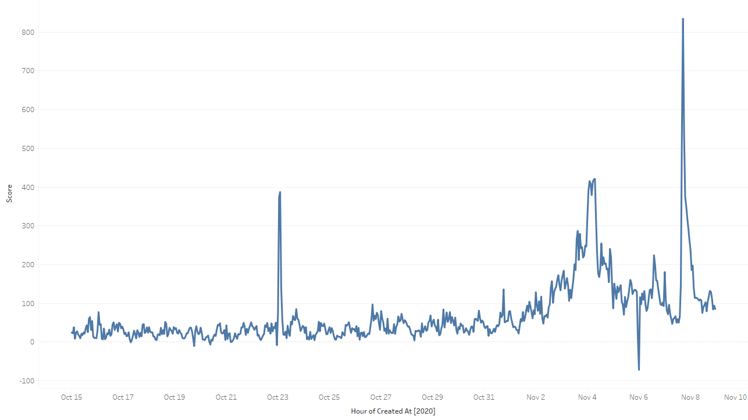
Trump Tweets
Notes:
On the Trump side, there are 3 peaks and one valley. We identified the following peaks and the driving event:
October 23rd, 2AM – Score 387 – Final Presidential Debate.
November 4th, between 2AM and 7AM – Score 418-421 – President Trump addresses the nation.
November 7th – 5PM – Score 834.3 – Four Seasons Total Landscaping press conference, race officially called for Joe Biden.
And our valley:
November 6th – Midnight – Score -71.8 – Trump Press conference.
As you can see, while the sentiment ebbs and flows each hour there were certainly spikes that we could correlate with events in the real world. Let’s take a look at the Biden chart next.

Slide 8
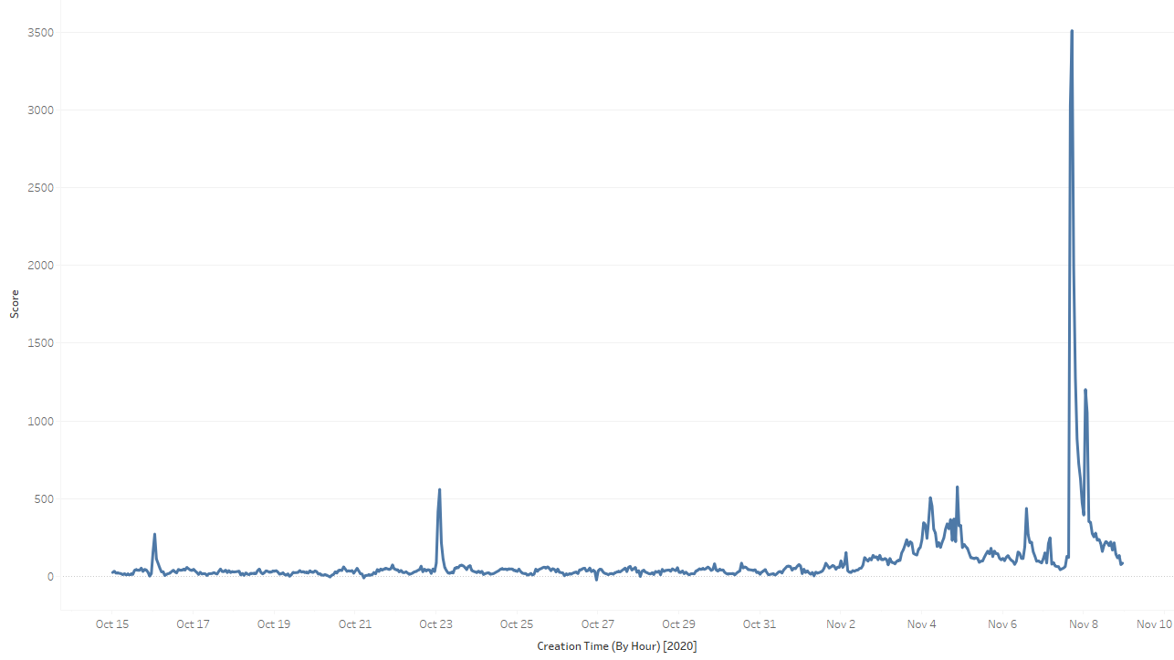
Biden Tweets
Notes:
The first thing to notice is that the peaks for Biden are significantly larger than the Trump peaks, and he had no valleys at all. We see 6 peaks for Biden.
October 16th – 1AM – 271 – Biden Town Hall in lieu of 2nd presidential debate.
October 23rd – 2AM – 559 – Same spike as Trump for the Presidential Debate.
November 4th – 5AM – 506 – Post election morning when more states began leaning Biden.
November 4th – 9PM – 576 – Biden clinches 264 electoral votes.
November 8th – 1AM – 1202 = Biden addresses the nation as President-Elect
November 7th – 5PM – 3512 – Biden reaches 270 electoral votes and clinches the election win.

Slide 9
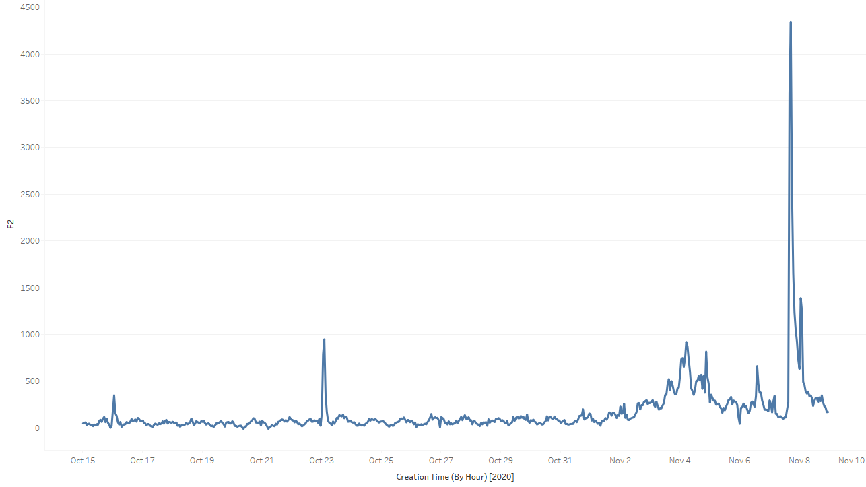
Combined Tweets
Notes:
We also looked what happens when you combine the scores for all tweets related to the Biden and Trump hashtags. As you can see, a little more positive here with no real negative peaks but it seems to hit all of the same benchmarks that the individual charts do.

Slide 10

Conclusion
Proof of concept
Distinct peaks
TextBlob Sentiment Analysis
Adaptability
Kyle
kymorris@my365.Bellevue.edu
Notes:
Overall, we are pleased with what we accomplished. We set out to do sentiment analysis on a recent world event, and I think we nailed it. We were pleased to see the peaks and valleys that we suspected we could find, and it was great to be able to correlate these moments with actual events in the outside world.
The best part is how easy this would be to adapt to other events: you could set up searches to run, enter a time period, and collect the data, then run this very same analysis on it. It’s very flexible!
Thank you so much for your time, and I hope this analysis was useful to you.

Slide 11
Q&A
Questions
You have shown that this analysis could be performed after the fact. Could this be done in real time as well?
Why a TextBlob?
Why did you choose the election for the analysis?
Is there any analysis you would have liked to perform but were unable to?
Why Twitter data specifically?
Were the results what you expected? Did you anticipate the spikes?
What challenges were you able to overcome?
Why Tableau for visualizations and not say GGPlot?
Any improvements you wish you could have made?
What is your biggest takeaway?
Notes:
Our data was imported into a Pandas dataframe from the Comma-Separated Values format it originally came in. Of the 1.748 million rows of data, roughly 20-30 were incomplete and removed from the dataset. This represented such a small portion of our dataset we were confident it wouldn’t affect our results much. The tweets were then cleaned of any special characters so as to limit our analysis to only the words used.
We used a library called TextBlob which adds some functionality to the Natural Language ToolKit. Essentially, we can give our TextBlob a string and it calculates the sentiment, or overall feel of the message. This sentiment is ranked from negative one to positive one, with extreme values representing a larger magnitude. Not only did we save this score for each tweet, but we also classified positive values, negative values, and when the score was 0, a neutral tweet.
Once our data had been processed, we imported the data into Tableau and created a few visualizations. We’ll check it out in a moment, but our graphs clearly show spikes in our sentiment analysis. We then correlated those spikes with real world election coverage to connect the dots.

